Slide 1
ESTIMATION FOR BUSINESS EXPENSES
1.INTRODUCTION:
1.1 OVERVIEW
This report deals into the facinating realm of business expenses and provides a visual exploration of the various expenditure incurred by different bussiness . It showcases the distrubution of expenses, identifies key cost drivers, and highlight areas of potential optimization or concern. The visual representation allow for intuitive analysis, facilitating a deeper understanding of expenditure patterns and their implication for business performance. Decision makers,financial analysts and stakeholders can gain valuable insights into the financial health of business, identify areas of inefficiency or opportunity, and make informed decision to optimise resourse and drive growth . To extract the insights from the data and put the data in the form of visualization , dashboards and story we employed tableau tool.
1.2 PURPOSE
Analysing business expenses has a profound impact on various aspects of business opertion s. it helps optimize costs,improve profitability, and ensure financial stability. Expense analysis enables businesses to allocate resourse effectively,make informed decisions, and create realistic budgets and forecasts. By understsnding and managing expenses, companiescan drive growth,maintain a strong financial position , and make strategic business decision with confidence.
2.1 EMPATHY M

Slide 2
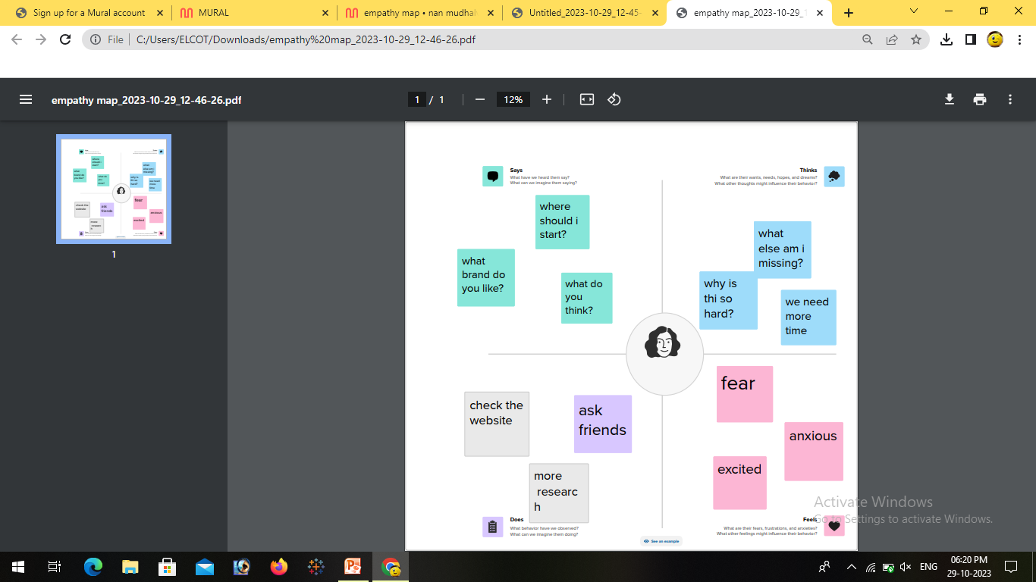
2.PROBLEM STATEMENT & DESIGN THINKING 2.1 EMPATHY MAP

Slide 3
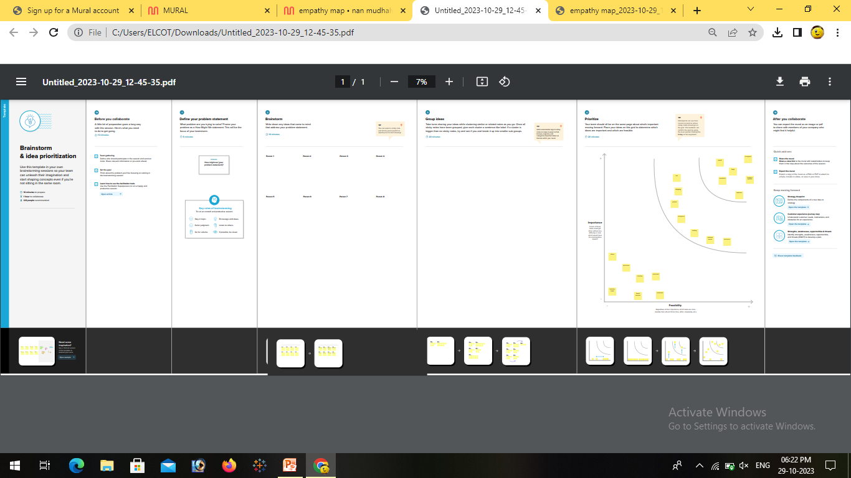
2.2 IDEATION AND BRAINSTROMING MAP

Slide 4
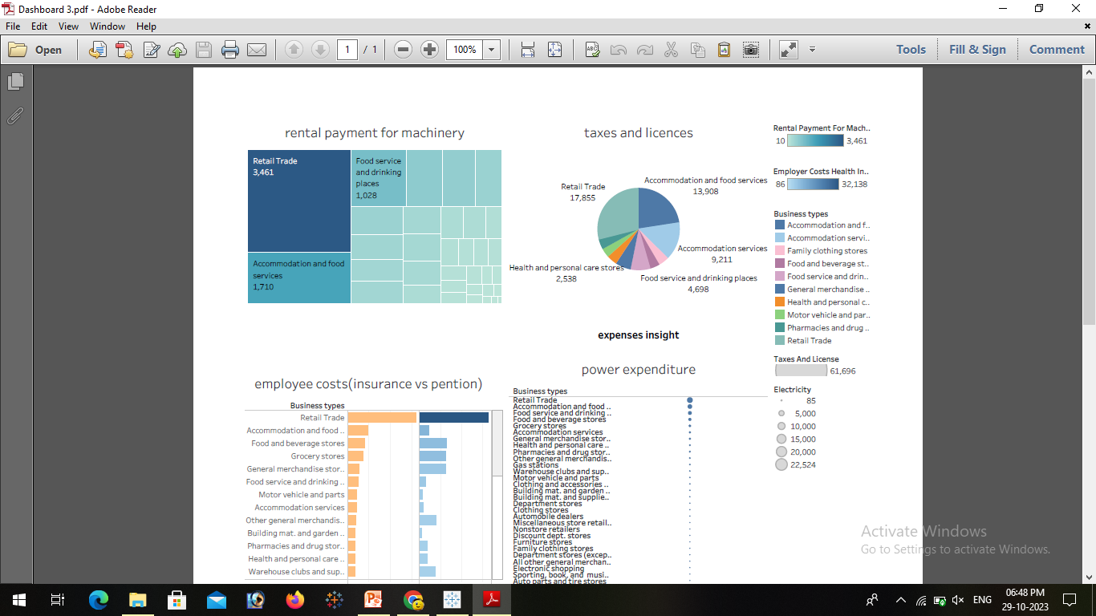
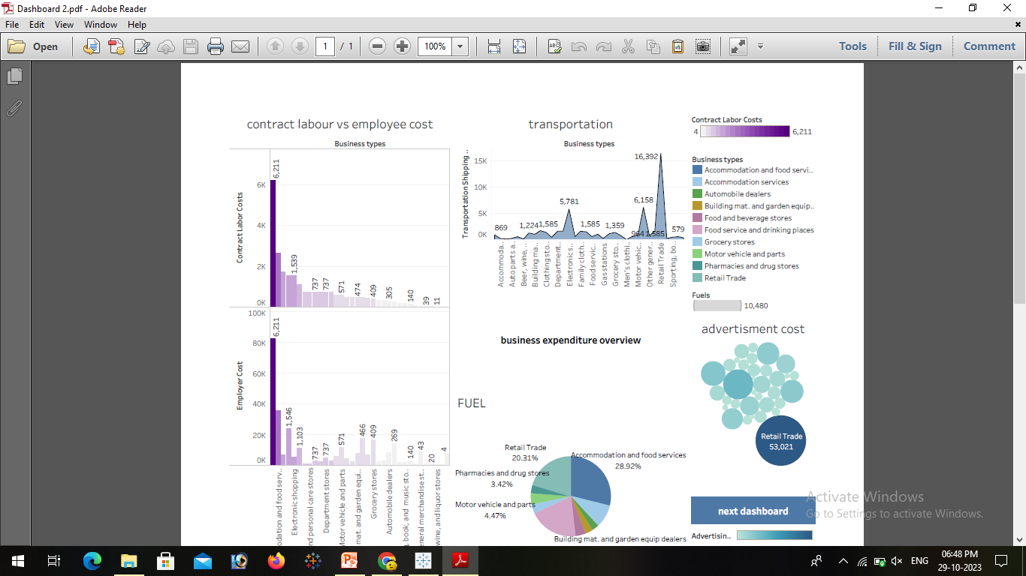
3. RESULT 3.1 DASHBOARD

Slide 5
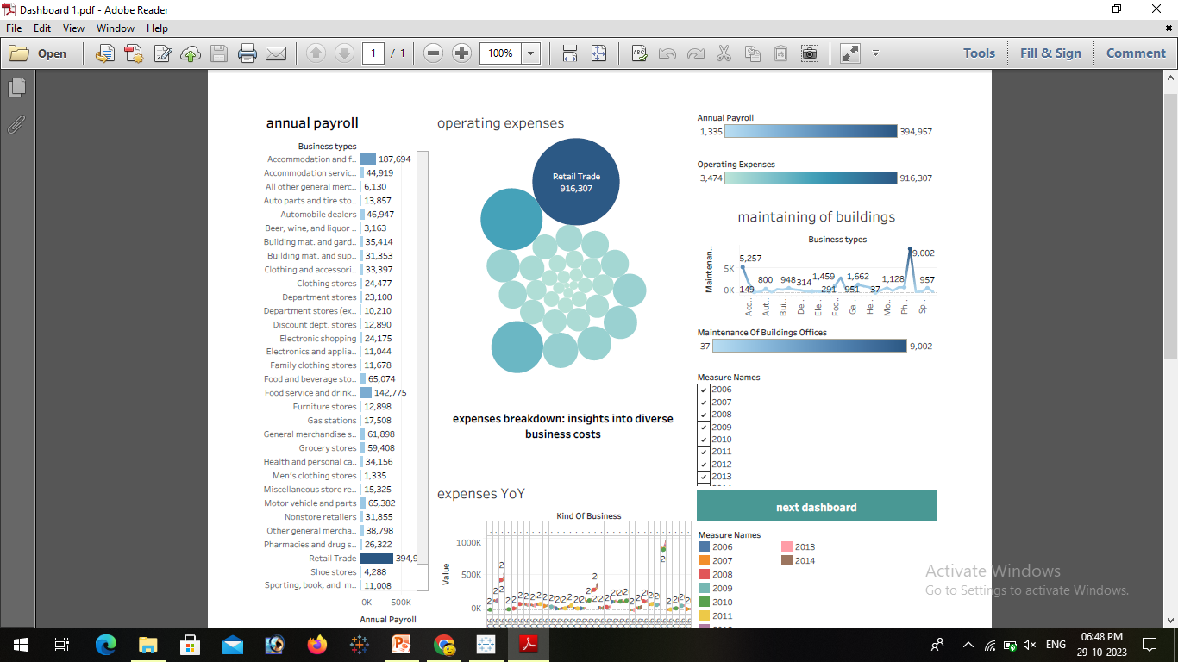

Slide 7
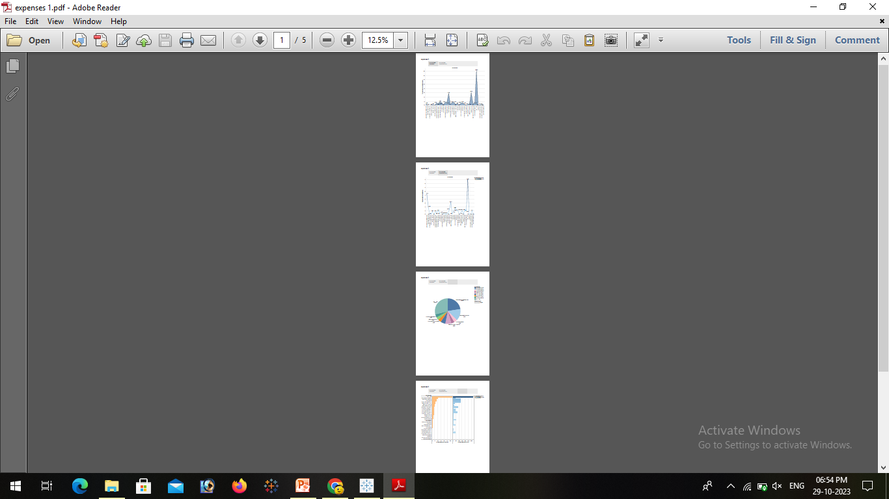
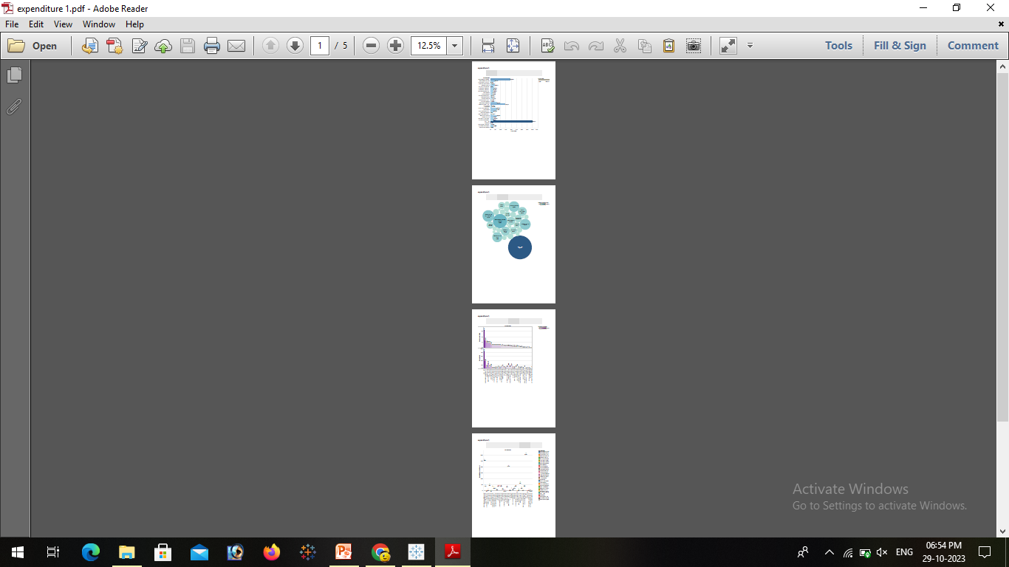
3.2 STORY

Slide 9
4.ADVANTAGE AND DISADVANTAGE
ADVANTAGE:
1. Improve efficiency
2. Quality improvement
3. learn activities
4. High performance
5. Develop real life skills
DISADVANTAGES:
1.Inaccurate and un realistic
2.Inflexible
3.Time consuming
4.Conflict

Slide 10
5.FUTURE HOPE
For a succesful project,proper project cost management is must!
In the end , your estimated time,resourses,and expenses are the ones that rule over your budget.
Your budget and project size ,on the other hand ,determine your project management costs and the cost of your project management software.

